Slide 1
Space4Arctic and more
Éric Laliberté
Associate Director General
VP Science & Technology Office
Canadian Space Agency
ᑲᓇᑕᒥ ᐊᓂᕐᓂᖃᕐᓇᖏᑦᑐᒥ ᓯᓚᑖᓂ ᓄᓇᕐᔪᐊᑉ ᐃᖅᑲᓇᐃᔭᑎ

Slide 2
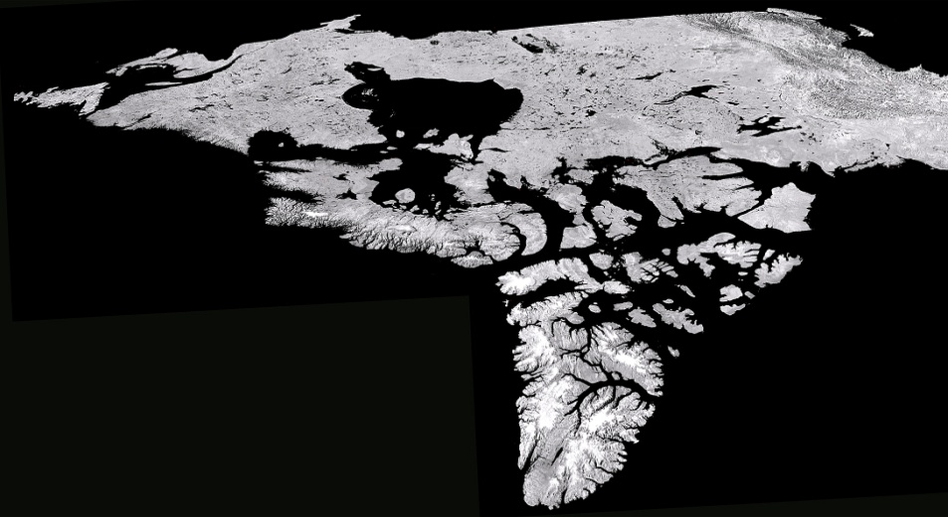

Slide 3
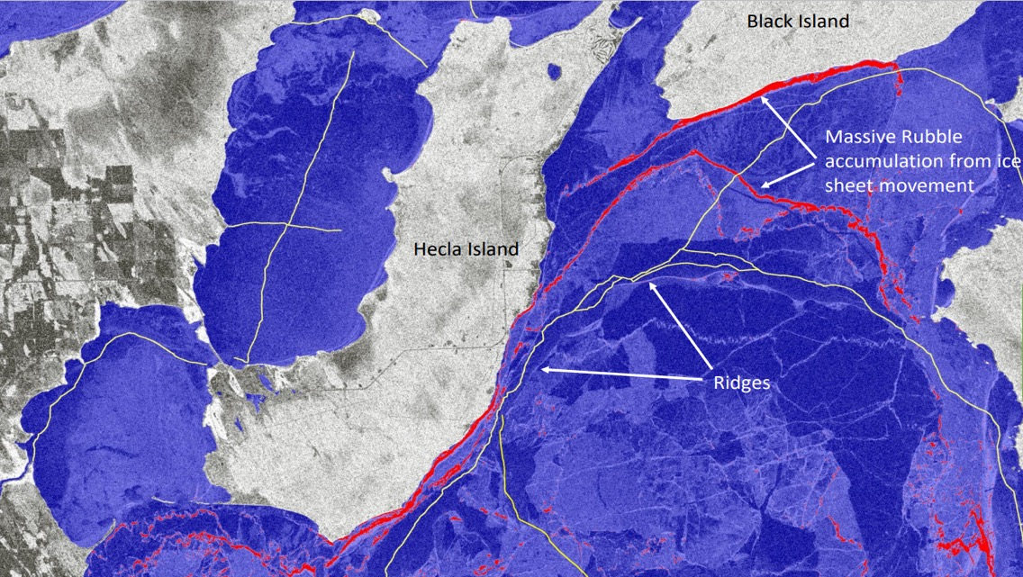
smartEarth: NextGen & First Nations in Manitoba
Lake Ice

Slide 4
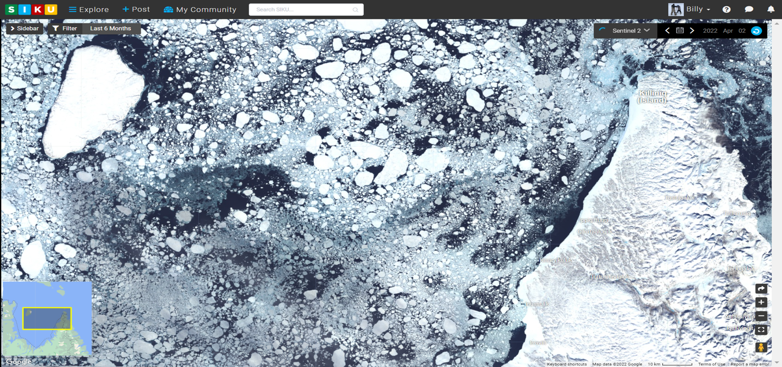
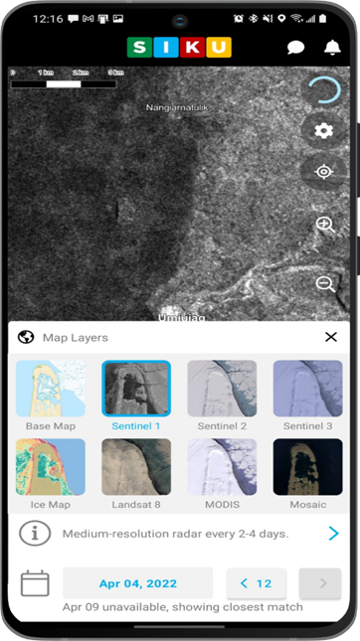
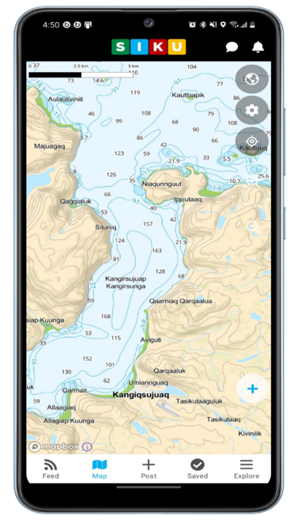
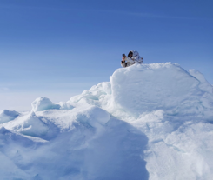
smartEarth: SIKU / Inuit Driven Platform

Slide 5
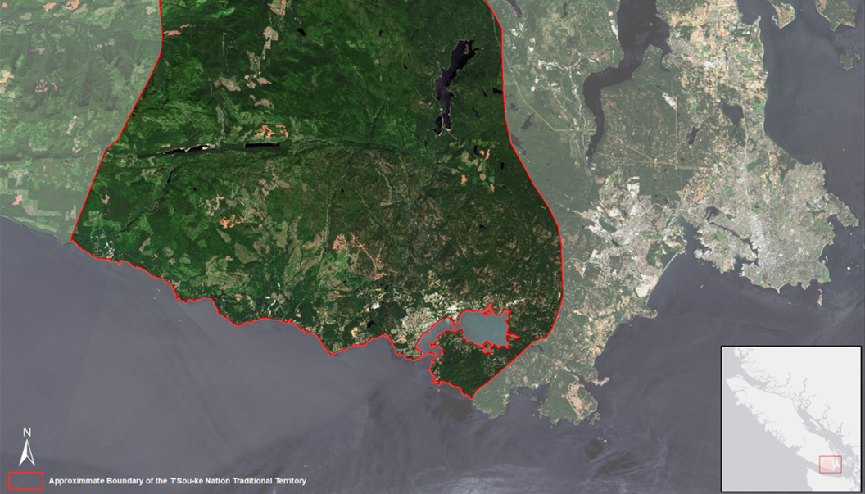
smartEarth: Vertex & T’Sou-ke First Nation

Slide 6
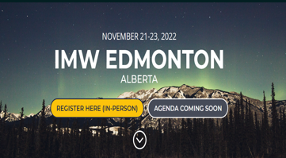
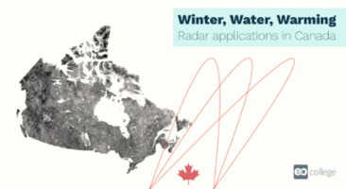
A success story of co-development and partnership
Canadian SAR MOOC
Joint CSA-NASA EO Training & Dialogue Sessions
2018-2021 2021-2022 2023+
EO capacity > Two-way learning, dialogue, story telling > Longer-term plan
Joint CSA-NASA Multi-Year Plan
(in development)

Slide 7
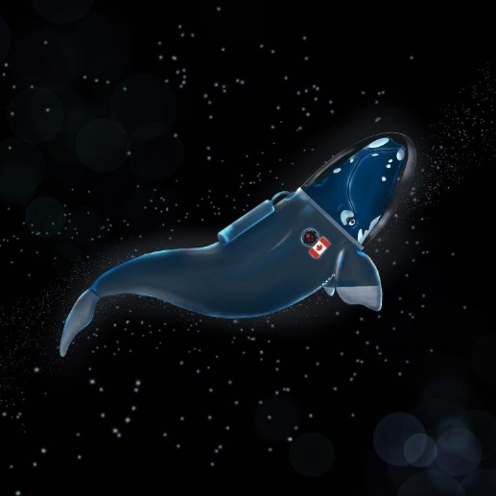
smartEarth: smartWhales
3 federal departments
5 multi-sectoral consortia
11 science organizations
8 foreign organizations
80 highly qualified personnel
50% new organizations involved
Notes:
The North Atlantic Right Whale (NARW) was listed as endangered under the Species at Risk Act (SARA) in 2005.
Objective: Develop Space-Based Solutions for the Monitoring and Protection of the North Atlantic Right Whale
Collaboration: Partnership between the Canadian Space Agency, the Department of Fisheries and Oceans and Transport Canada
2 approaches: Habitat modelling / Detection (AI)
There are fewer than 350 left in the World

Slide 8
Committee on Earth Observation Satellites Biodiversity

Slide 9
RCM Composite Imagery of Hudson Bay / Wapusk National Park Area
October 13, 2023 and February 6, 2024
Single Date: Composite: Composite:
Feb. 6, 2024 Feb 6, 2024 & Oct. 13, 2023 LAND (Oct&Feb) + Sea (Feb)
Image credit : Canadian Space Agency, contains RADARSAT Constellation Mission data (2023), processed by Dromadaire Geo-Innovations
Notes:
-The RADARSAT Constellation Mission (RCM) recently imaged the Churchill and Wapusk National Park area along Hudson Bay. These examples showcase how image processing can enhance mapping of environmental conditions and thus contribute up-to-date information to land and marine area management.
The image on the left was captured most recently on February 6, 2024, when snow (on the land) and sea ice (on the Bay) dominated surface conditions. The image in the middle is a composite, where 2 RCM images of that very same area were ‘sandwiched; note the more detailed content of the land side, and the less detailed content on the seaward side of the coastline. Finally, the composite image on the right combines the detailed land area coverage (Oct 10, 2023/Feb 6, 2024) and the detailed view of the sea ice conditions of Feb 6, 2024.
-Image credit : Canadian Space Agency, contains RADARSAT Constellation Mission data (2023), processed by Dromadaire Geo-Innovations.
-Products developed through the CSA EO Vista initiative.

Slide 10
North West Passage
Succession of RCM imagery

Slide 11
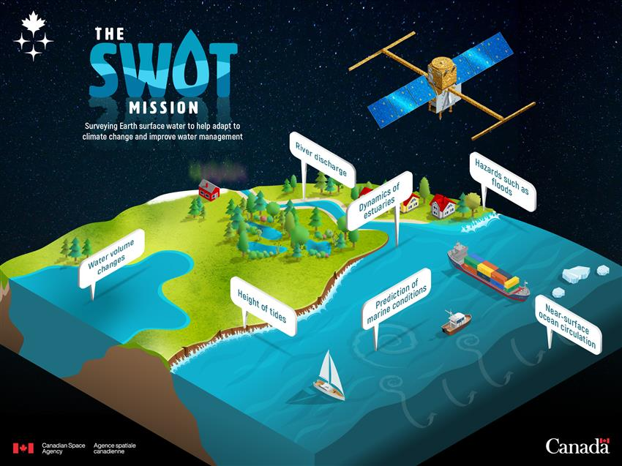
Surface Water and Ocean Topography (SWOT)

Slide 12
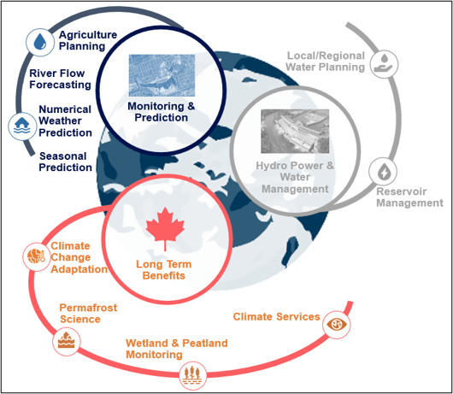
Terrestrial Snow Mass Mission (TSMM)
TSMM is a proposed radar mission to inform climate services and improve environmental predictions for snow covered regions
Climate change adaptation
Monitoring and prediction
Water management

Slide 13
Arctic Observing Mission (AOM)

Slide 14
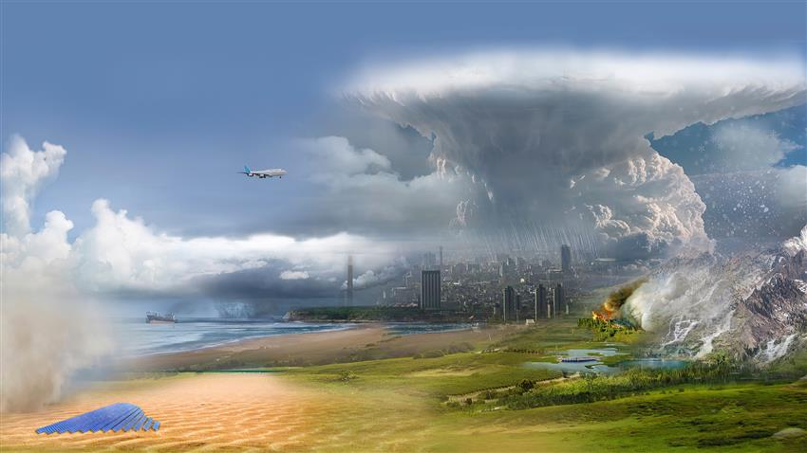
High-altitude Aerosols, Water vapour and Clouds (HAWC)
HAWC is a Canadian mission on NASA’s Atmosphere Observing System, a four-satellite constellation.
It will support extreme weather prediction, climate modelling and disaster monitoring.
14

Slide 15
Climate Change and Impacts
https://www.asc-csa.gc.ca/videos/recherche/1_evjubu0h/1_nljith46.webm
15

Slide 16
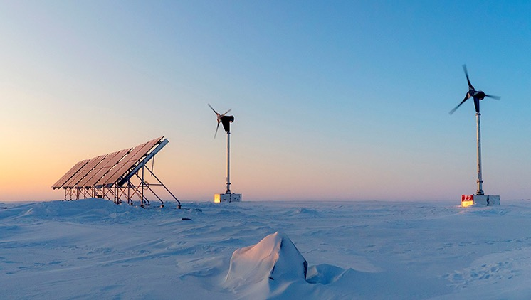

Slide 17
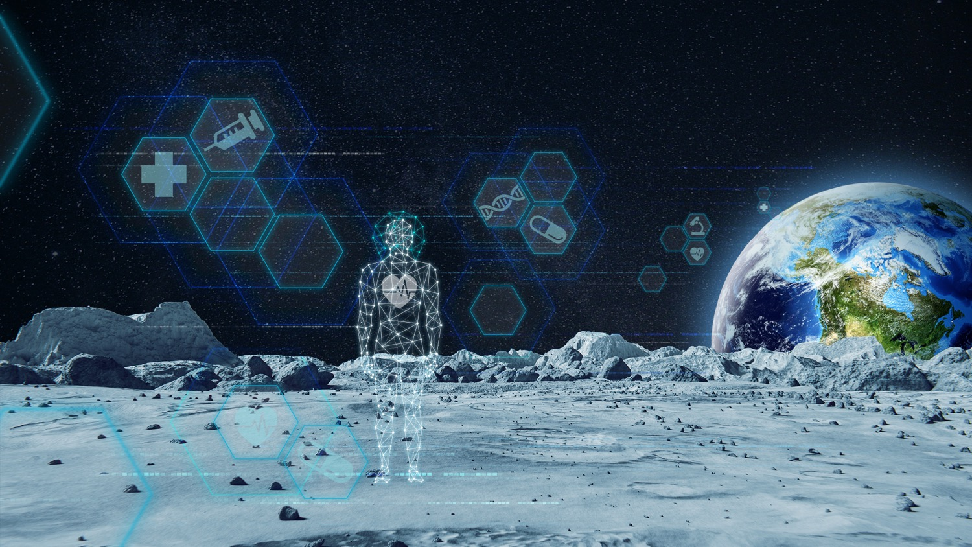

Slide 18
